Slide 1
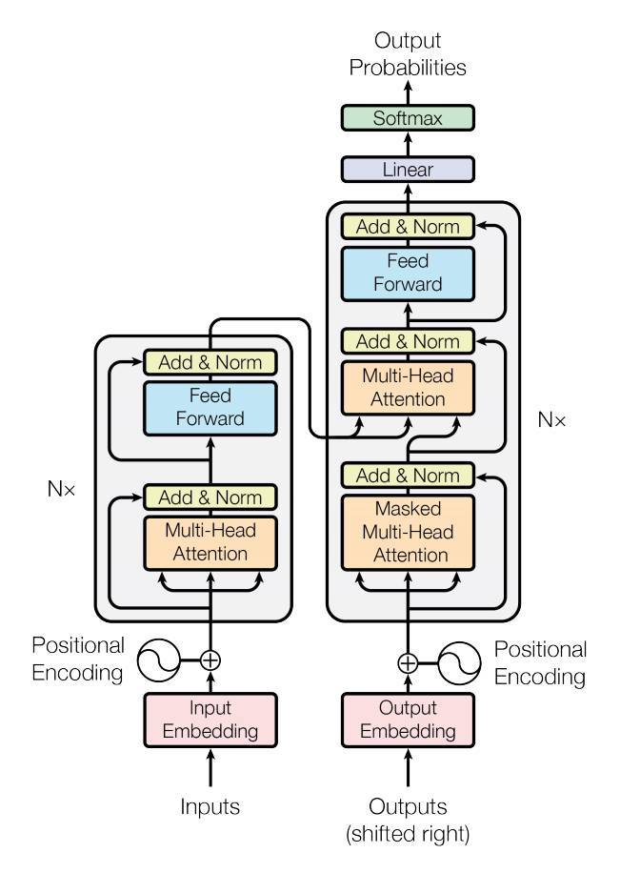
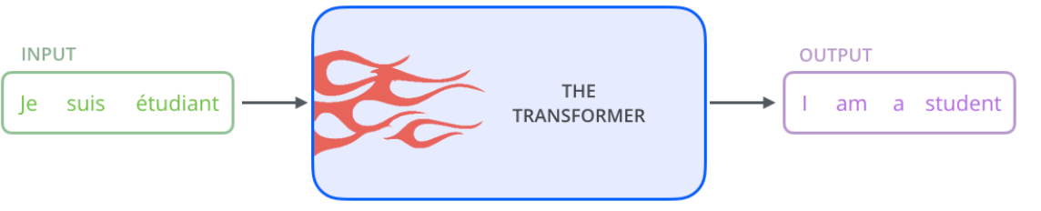
TRANSFORMER ARCHITECTURE
uses attention -> boost speed

Slide 2
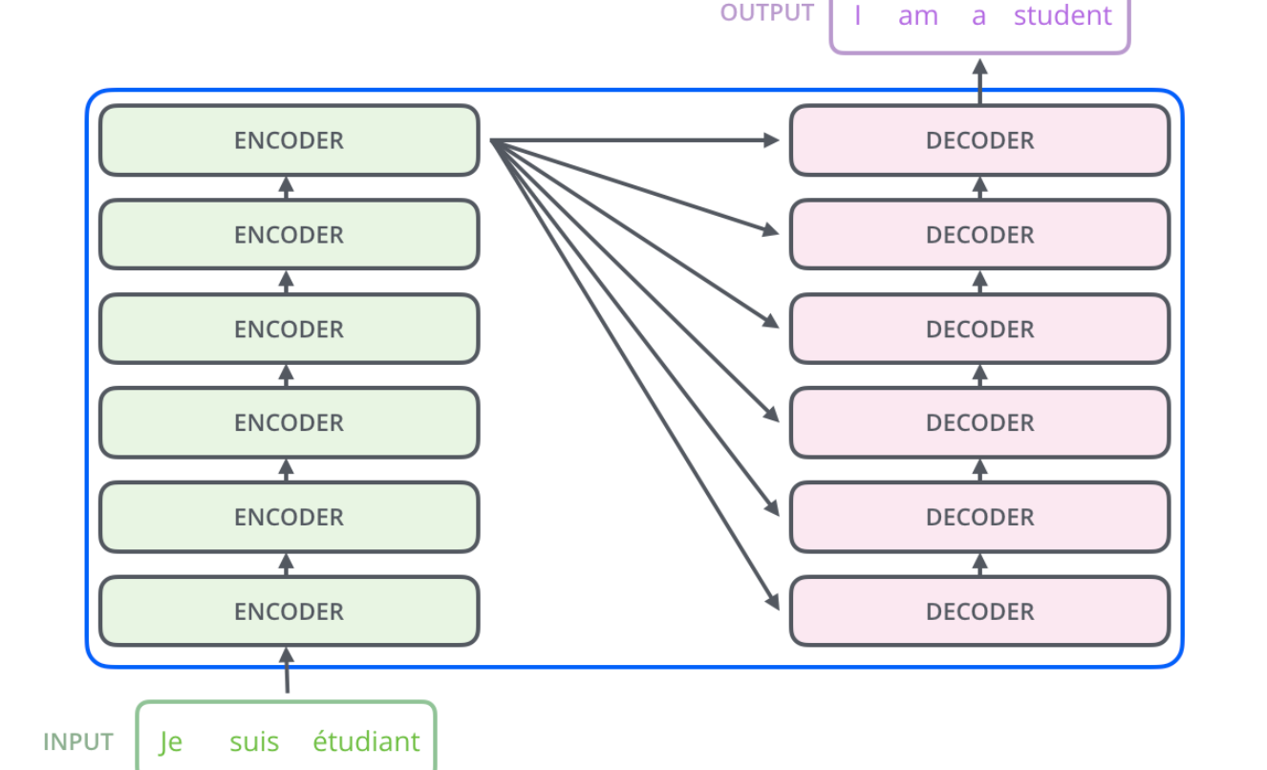
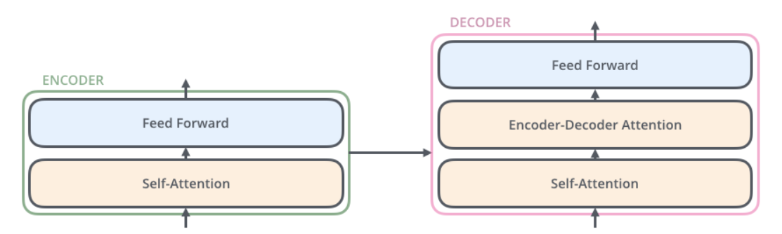
High-Level Look
N=6 -> same structure but not share weights
-self-att: xem xét các từ khác khi mã hóa 1 từ.
Encoder stack
(transformer encode blocks)
Decoder stack
(transformer decode blocks)

Slide 3
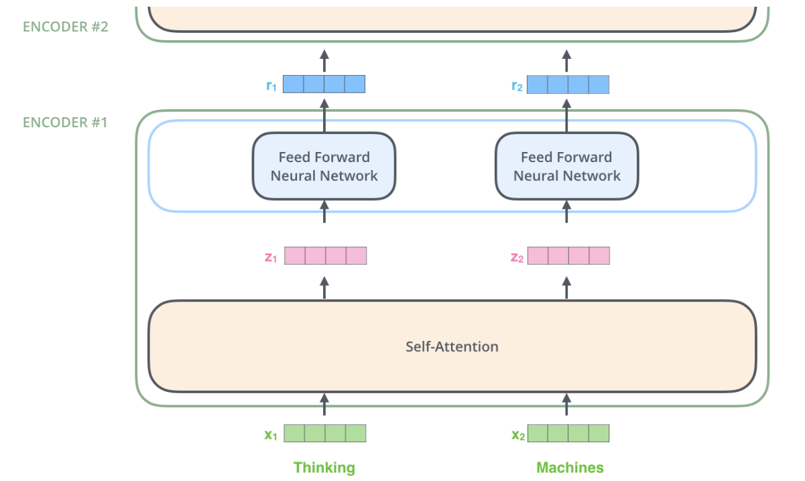
Self-Attention
word -> word embedding -> vector size 512
Word embedding only bottom-most encoder, others -> output of the encoder that’s directly below
self-attention -> dependencies between paths
feed-forward -> non
-> parallel in feed forwad

Slide 4
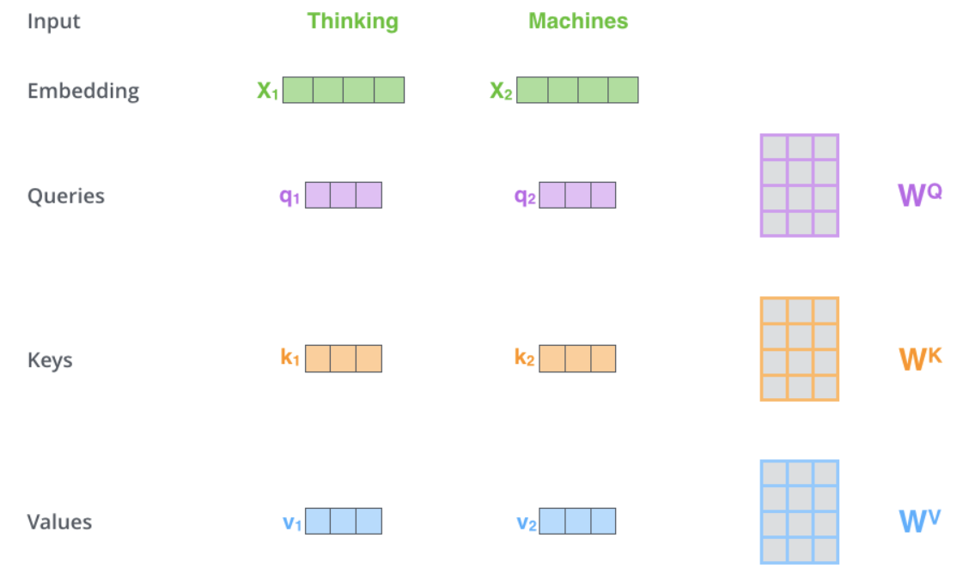
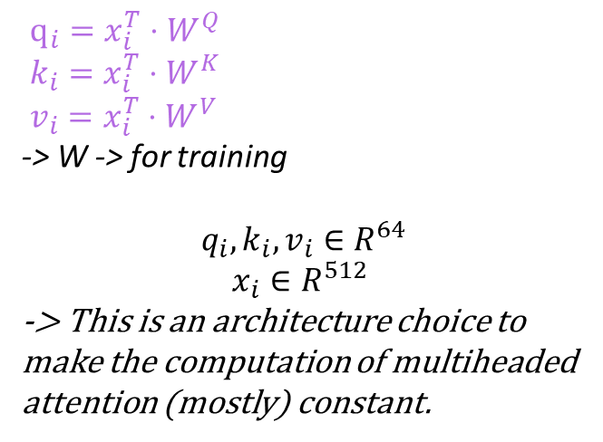
Self-Attention word-level
$q_{i}=x_{i}^{T}⋅W^{Q}$
$k_{i}=x_{i}^{T}⋅W^{K}$
$v_{i}=x_{i}^{T}⋅W^{V}$
-> W -> for training
$$q_{i},k_{i}, v_{i}∈R^{64}$$
$$x_{i}∈R^{512}$$
-> This is an architecture choice to make the computation of multiheaded attention (mostly) constant.

Slide 5
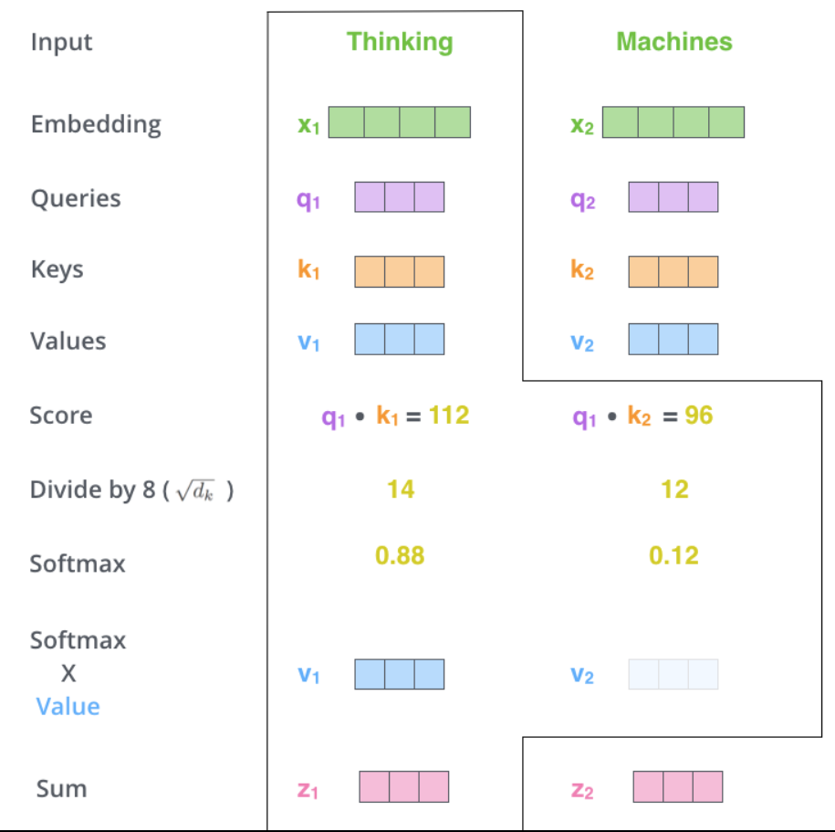
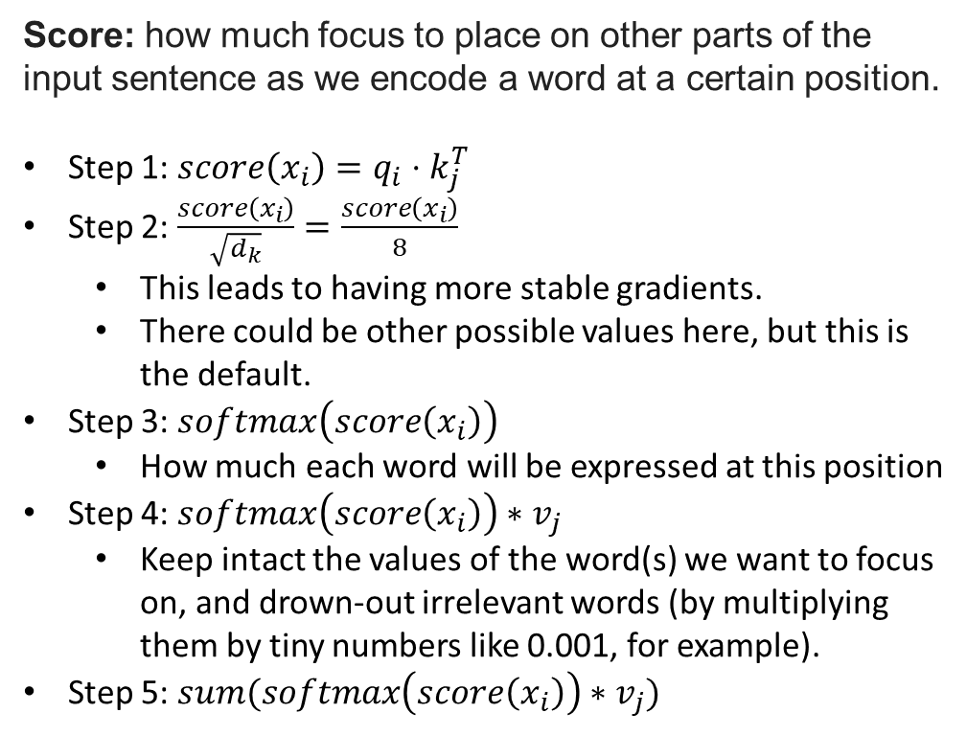
Self-Attention word-level
Score: how much focus to place on other parts of the input sentence as we encode a word at a certain position.
Step 1: $score\left(x_{i}\right)=q_{i}⋅k_{j}^{T}$
Step 2: $\frac{score\left(x_{i}\right)}{\sqrt{d_{k}}}=\frac{score\left(x_{i}\right)}{8}$
This leads to having more stable gradients.
There could be other possible values here, but this is the default.
Step 3: $softmax\left(score\left(x_{i}\right)\right)$
How much each word will be expressed at this position
Step 4: $softmax\left(score\left(x_{i}\right)\right)∗v_{j}$
Keep intact the values of the word(s) we want to focus on, and drown-out irrelevant words (by multiplying them by tiny numbers like 0.001, for example).
Step 5: $sum(softmax\left(score\left(x_{i}\right)\right)∗v_{j})$

Slide 6
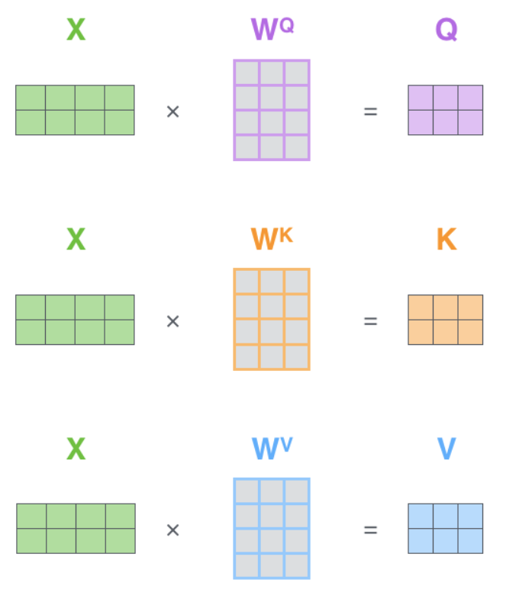
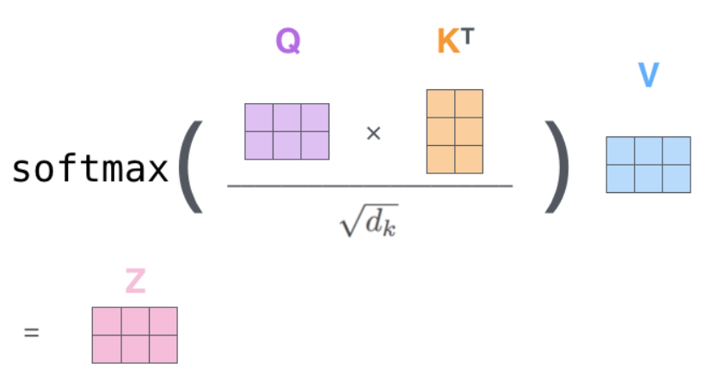
Self-Attention matrix
Packing embedding vectors -> matrix -> faster process

Slide 7
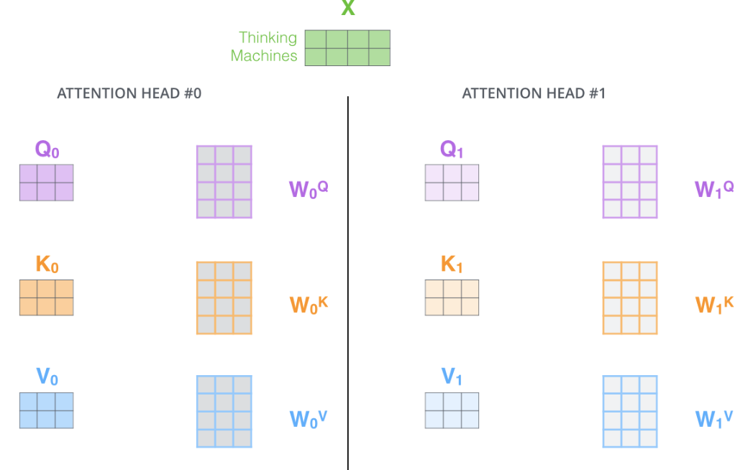
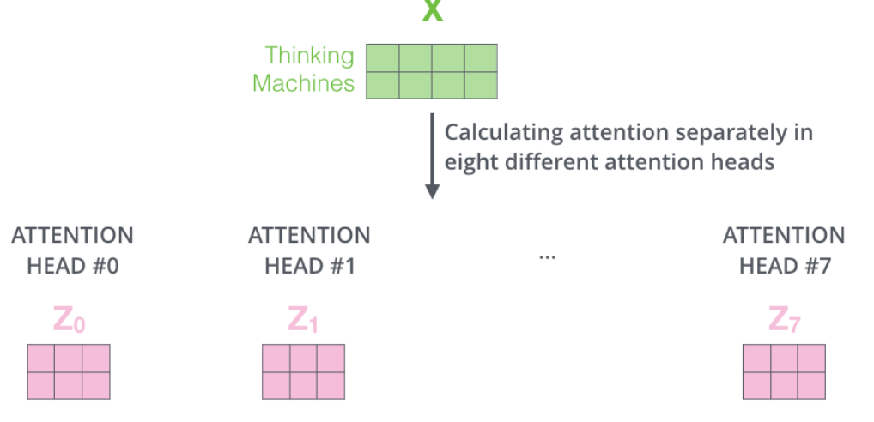
Self-Attention multi-head
Học các quan hệ khác nhau: ngữ nghĩa, vần,…
Improves the performance:
Expands the model’s ability to focus on different positions
Attention layer multiple “representation subspaces”. Many Q/K/V matrix; after training, each set is used to project the input embeddings (or vectors from lower encoders/decoders) into a different representation subspace.

Slide 8
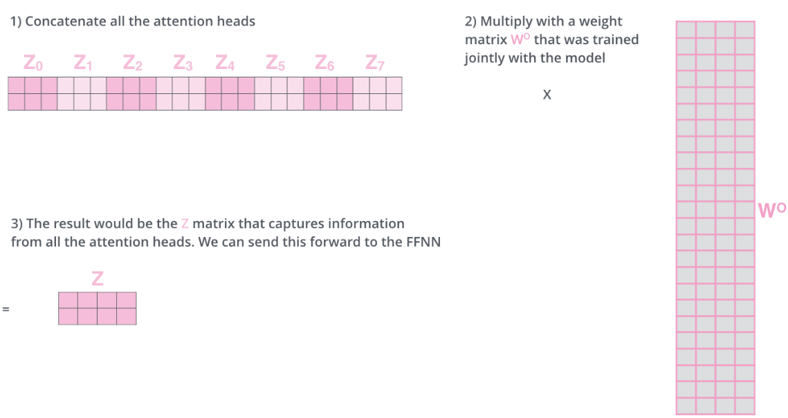
Self-Attention multi-head
Feed-forward layer is not expecting 8 matrix -> multiply $W^{o}$

Slide 9
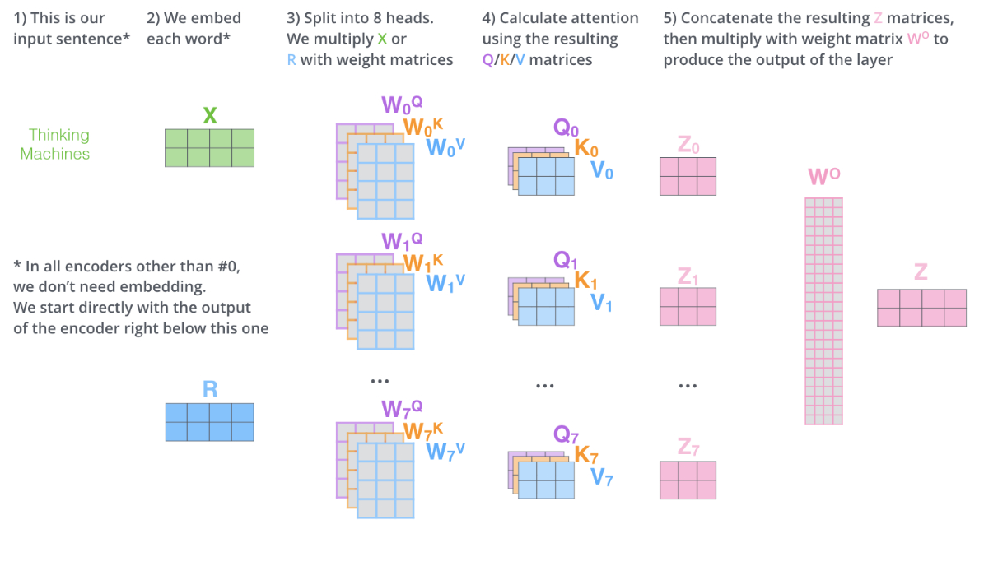
Self-Attention

Slide 10
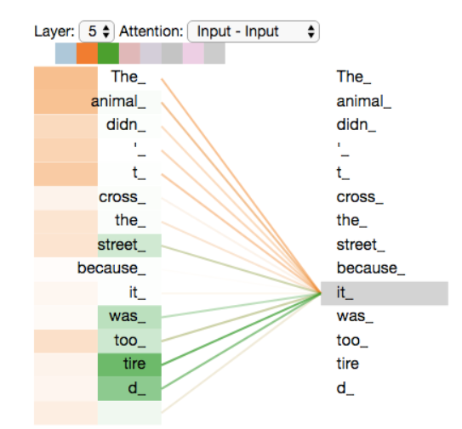
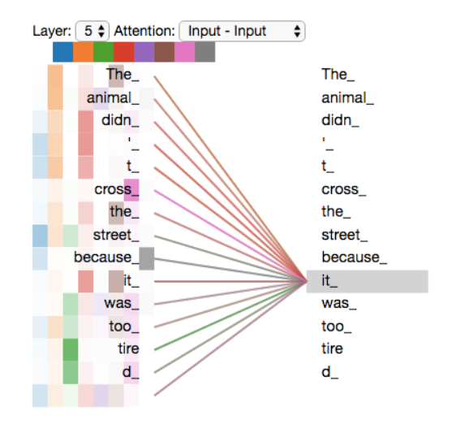
Self-Attention
one attention head
multi attention head

Slide 11
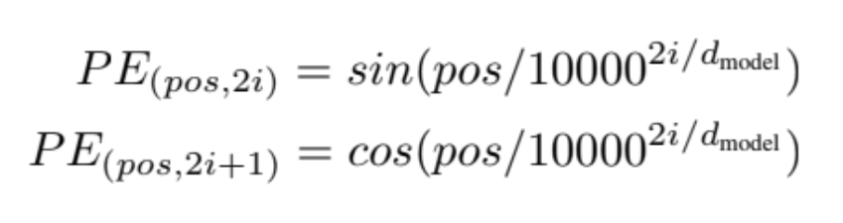
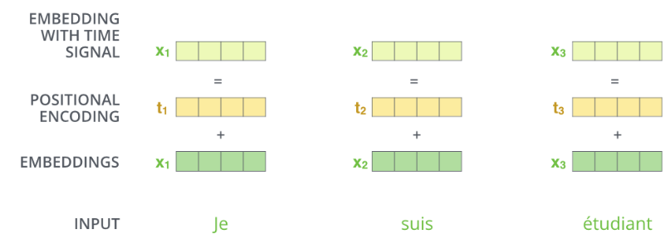
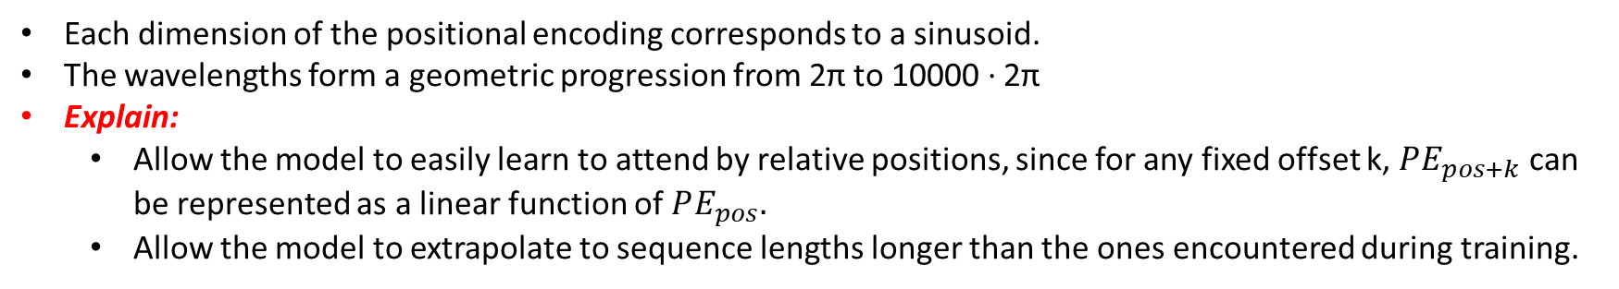
Positional Encoding
Adding these values to the embeddings provides meaningful distances between the embedding vectors once they’re projected into Q/K/V vectors and during dot-product attention.
Each dimension of the positional encoding corresponds to a sinusoid.
The wavelengths form a geometric progression from 2π to 10000 · 2π
Explain:
Allow the model to easily learn to attend by relative positions, since for any fixed offset k, $PE_{pos+k}$ can be represented as a linear function of $PE_{pos}.$
Allow the model to extrapolate to sequence lengths longer than the ones encountered during training.

Slide 12
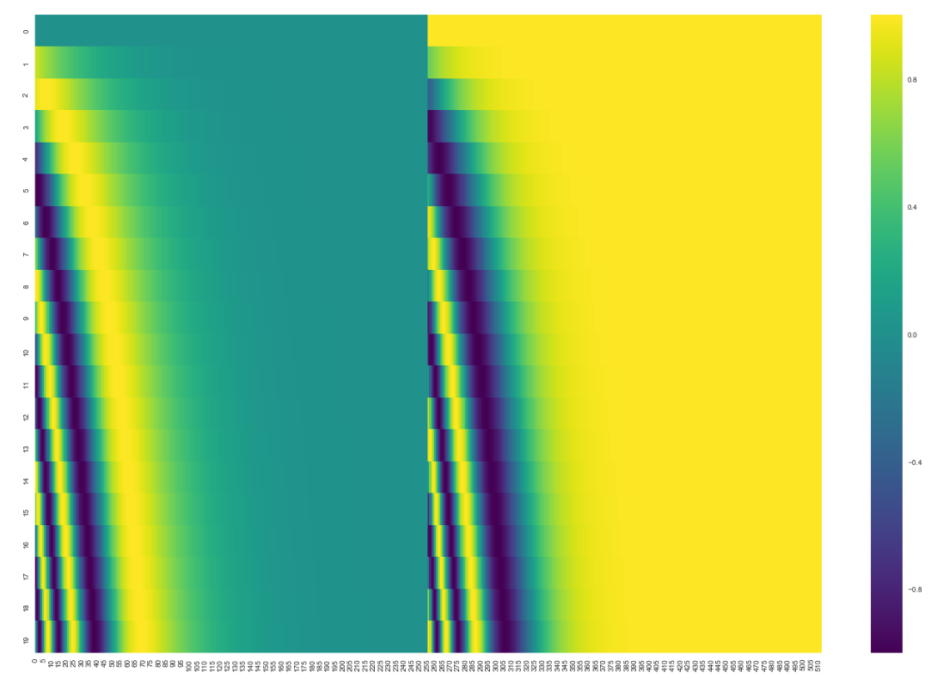
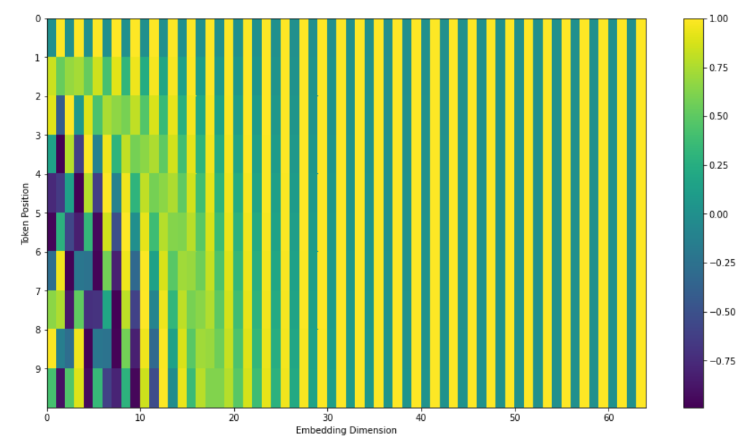
Positional Encoding
Tensor2Tensor implementation of the Transformer
Paper

Slide 13
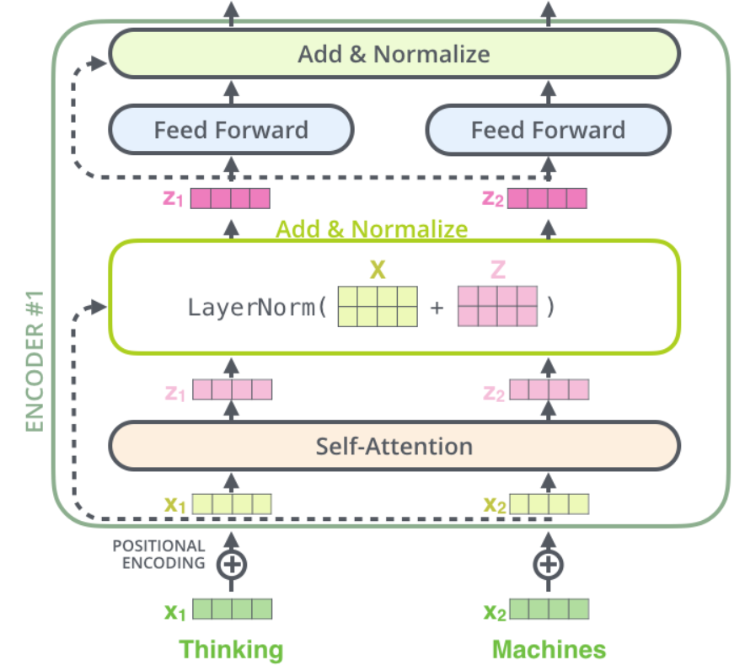
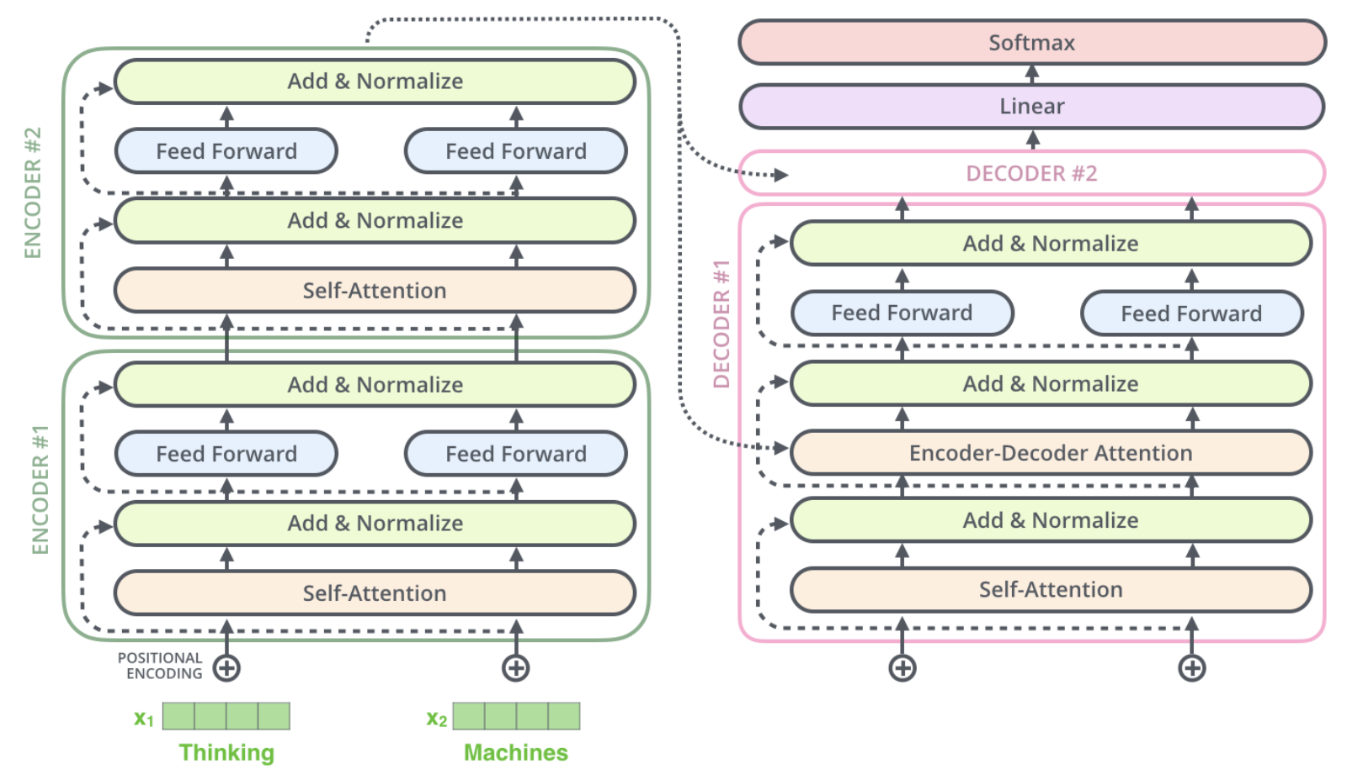
Residuals
residual -> add & normalize
sub-layers of the decoder as well

Slide 14


Decoder
Encoder process input.
Output of the top encoder is then transformed -> set of attention vectors K and V.
Be used by each decoder in its “encoder-decoder attention” layer
Helps the decoder focus on appropriate places in the input sequence.
Encoding: all input
Output: shift right -> <s> {seq} <eos>
Masking: future positions (setting them to -inf) -> softmax -> ~0.
Decoding: each word in output -> use masking

Slide 15
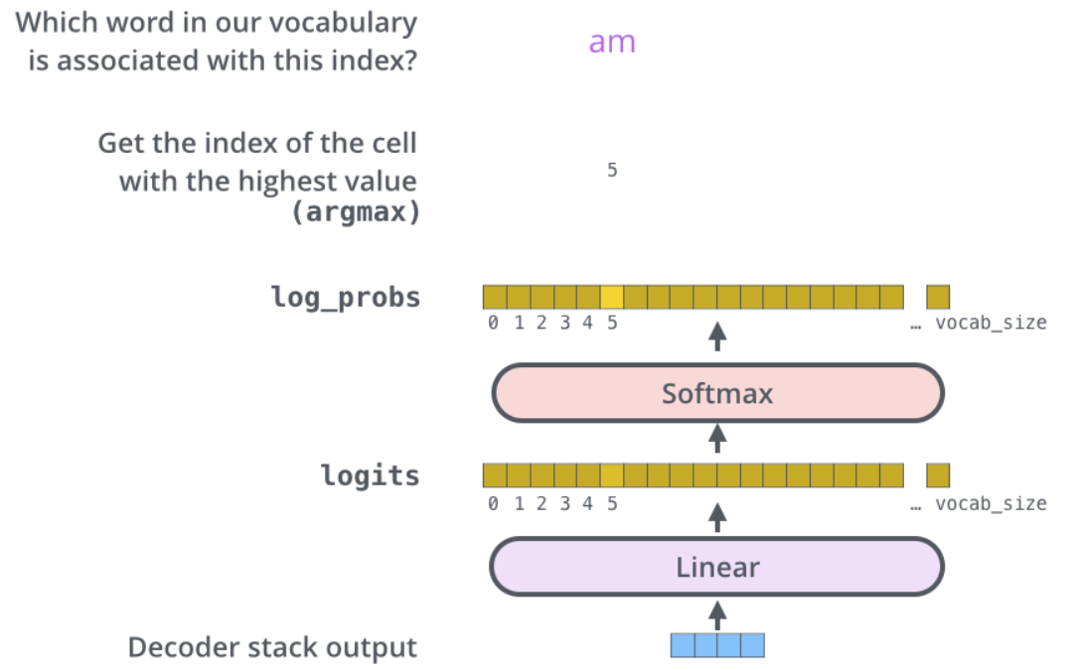
Linear and Softmax Layer
Linear: simple fully connected neural network -> much larger vector (vocab size: size of training model) (logit vector)
Softmax: probabiility -> highest.

Slide 16
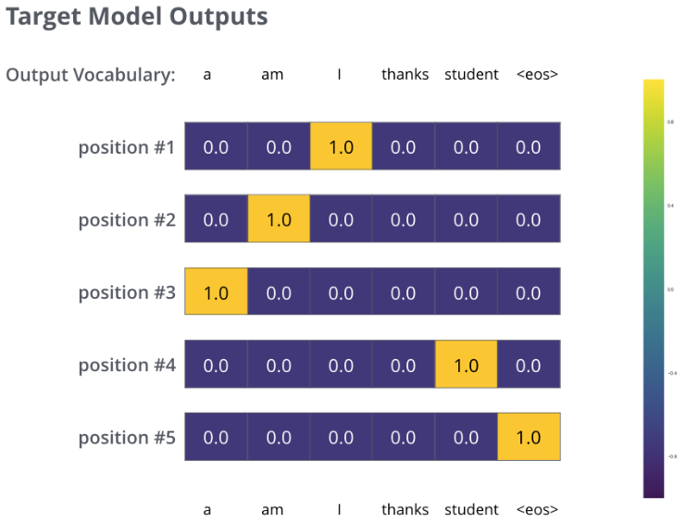
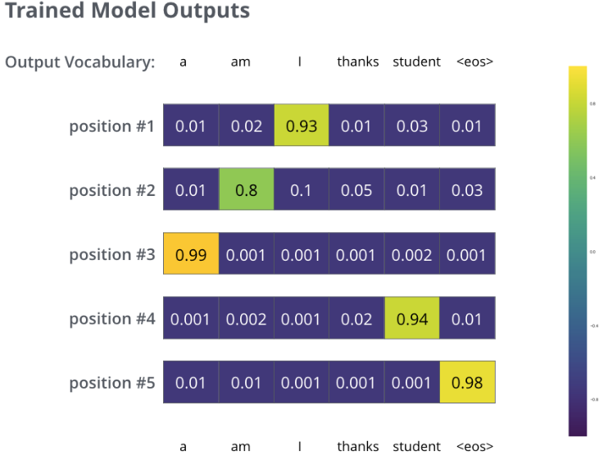
Loss Function
Each position gets a little bit of probability even unlikely to be output -> useful property of softmax in training process.
Inference:
Greedy Search: highest probability
Beam Search: less loss than, beam_size

Slide 17
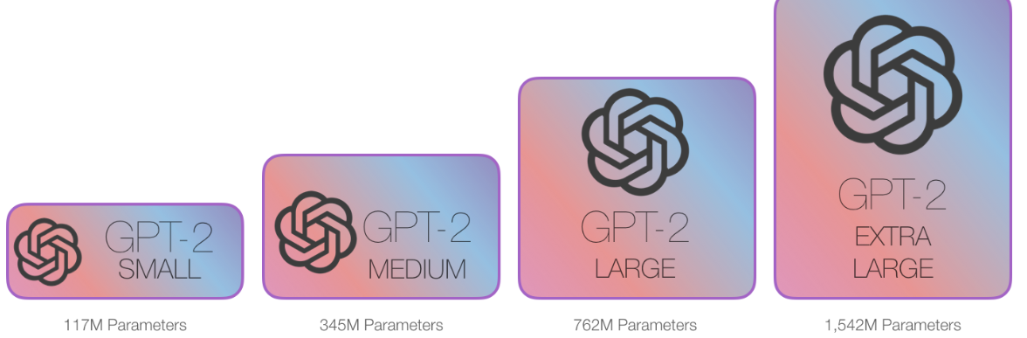
Language Model
Decoder-only transformer on a massive dataset, GPT-2 was trained on a massive 40GB dataset called WebText:
Smallest: 500MBs for store all parameters.
Largest: 6.5GBs of storage space.
ML model able to:
Look at part of a sentence.
Predict the next word.

Slide 18
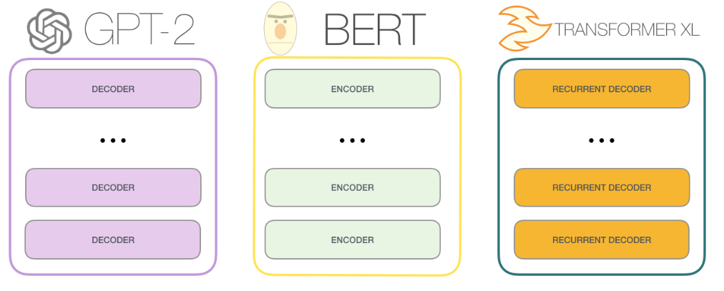
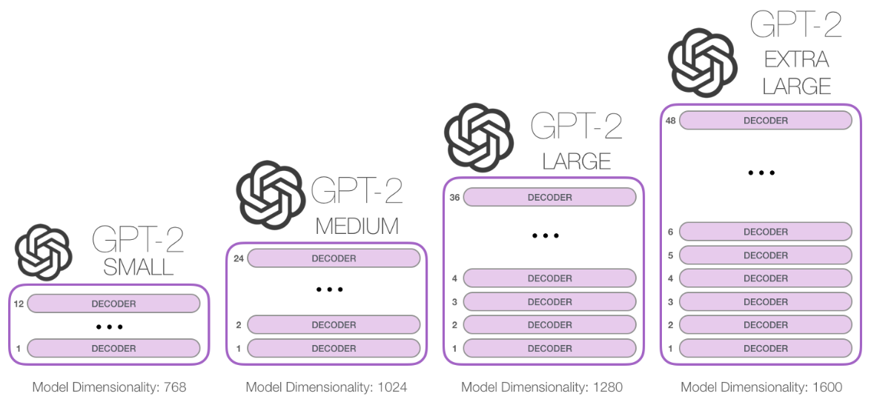
Transformers for LM
Transformers (encode + decode) -> success for machine translation
Only encode/decode -> possible

Slide 19
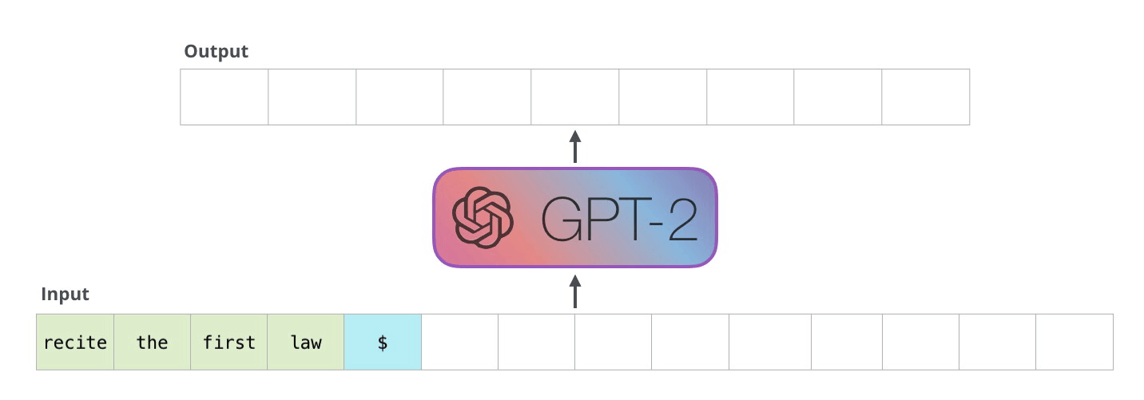
GPT2 vs BERT
New input = seq of input + [token,…] -> output token
auto-regression: GPT2, TransformerXL
-> BERT losing auto-regression -> ability to incorporate the context on both sides of a word to gain better results
-> XLNet autoregression and finding an alternative way to incorporate the context on both sides.

Slide 20
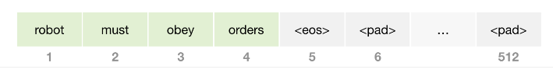
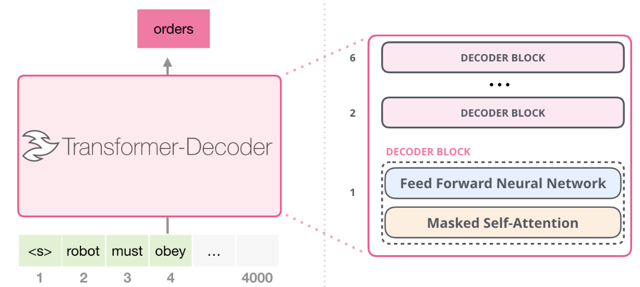
Evolution of the Transformer Block Decoder-only block
inputs (encode) have padding for rest of seq
BERT -> use self-att -> allows a position to peak at tokens to its right
GPT2 -> use masked self-att -> prevents _____
Character-Level Language Modeling
Deeper Self-Attention

Slide 21
GPT2::High-look
ramble -> generating unconditional samples -> input: only <|endoftext|> or <s>.
prompt -> generating interactive conditional samples
RAMBLE:
1 token (<s>) -> 1 path -> vector is produced along that path -> scored with vocab (GPT2: 50k words)
-> highest probability (top-k=1) -> the
-> or top-k sampling words other than the top word
Token output -> use for input (<s>, the) -> only second path is active (each layer has retained its own interpretation of 1st token and will use it in processing 2nd token) (not re-interpret 1st token in light of 2nd token)

Slide 22
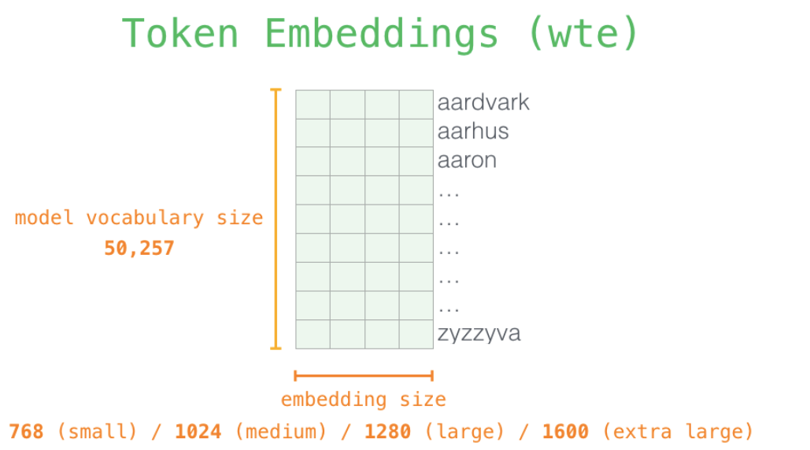
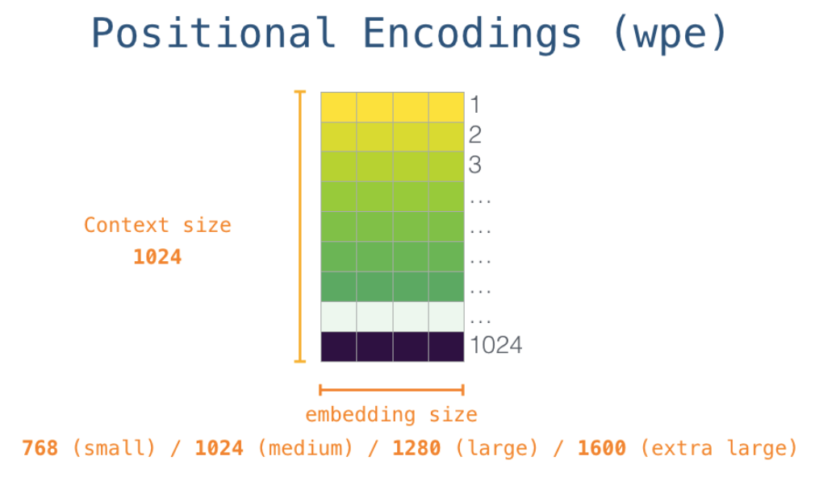
GPT2::Deeper-look::Token-pos-emb

Slide 23
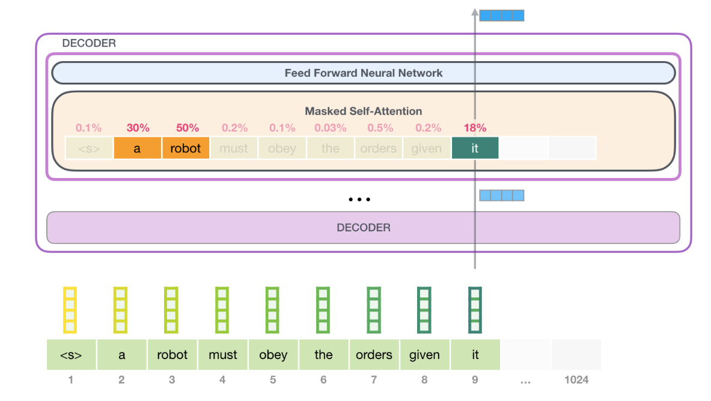
GPT2::Deeper-look::Blocks
Self-att: processing that word
Neur-net: scores to how relevant each word
The process is identical in each block, but each block has its own weights in both self-attention and the neural network sublayers

Slide 24
GPT2::Deeper-look::Self-att
Along the path of each token in the segment, includes:
Query: representation cur-word used to score against all-word (using key).
Key: label for word in segment -> match in search for relevant-word.
Value: actual word representations
Dot(Q, K) -> softmax -> sum(score*V)

Slide 25
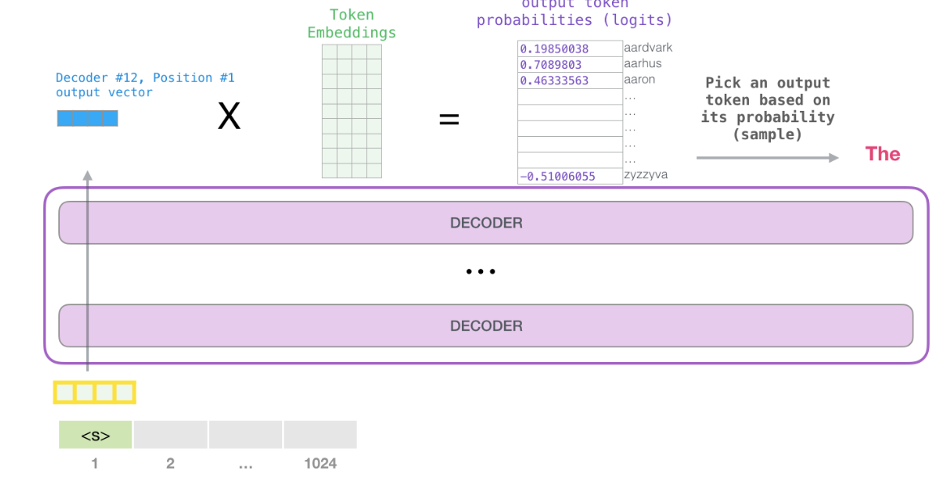
GPT2::Deeper-look::Output
Use top-k=40
-> repeat until gen 1024 or catch <eos>

Slide 26
Note
GPT2 uses Byte Pair Encoding to create the tokens in its vocabulary -> token is part of word.
Training mode: longer sequences, processing multiple tokens at once, process larger batch sizes (512).
Inference/evaluation mode: processing one word at a time, batch size of one.

Slide 27
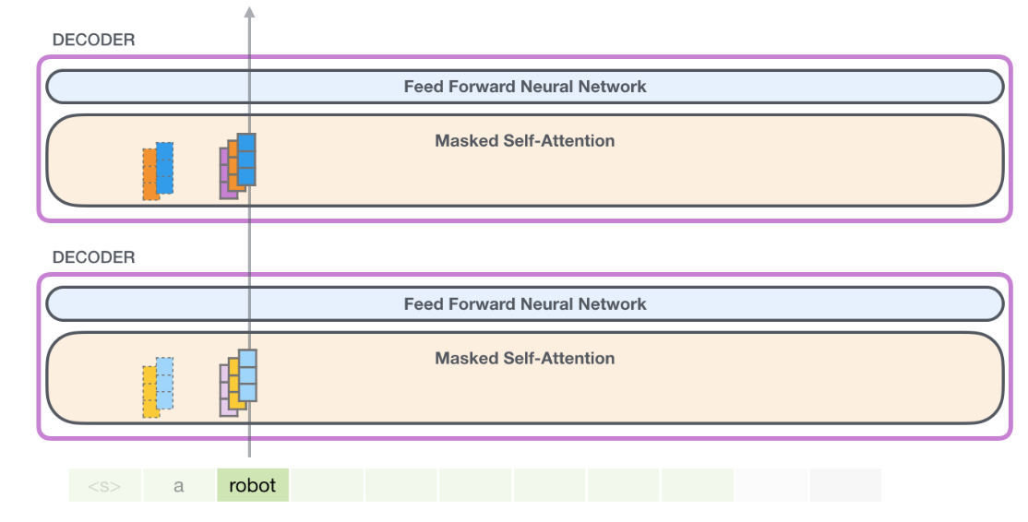
Eval Time: One Token at a Time
Holds K & V of previous tokens.
In next iter, model don’t need generate K & V of pre-tokens, just reuse

Slide 28
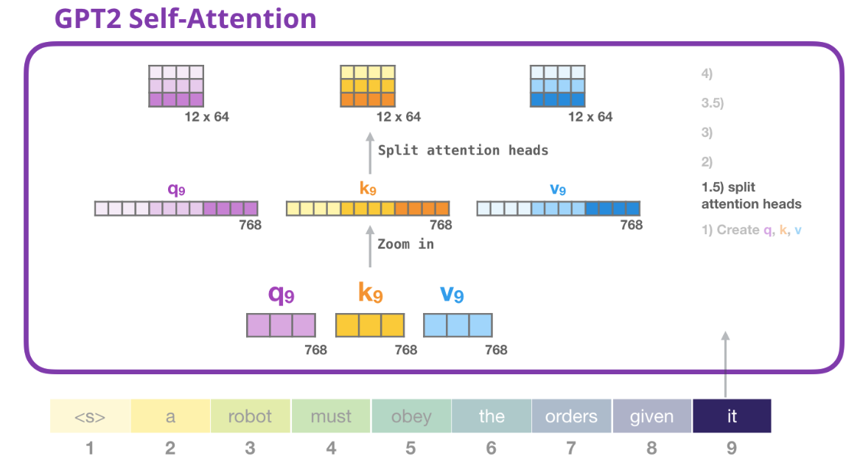
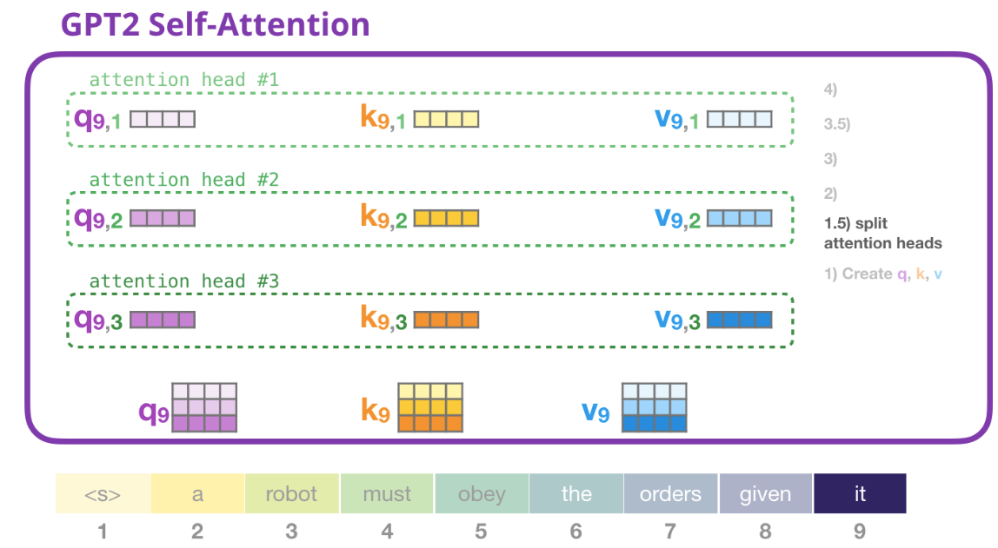
Splitting attention head
Split QKV -> reshape QKV (12, -1) -> 12 head

Slide 29
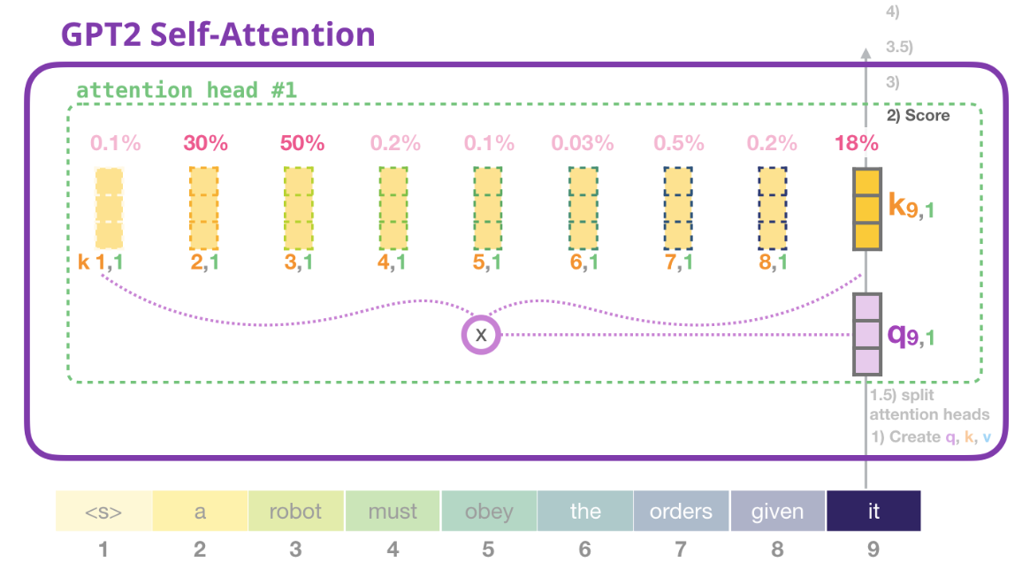
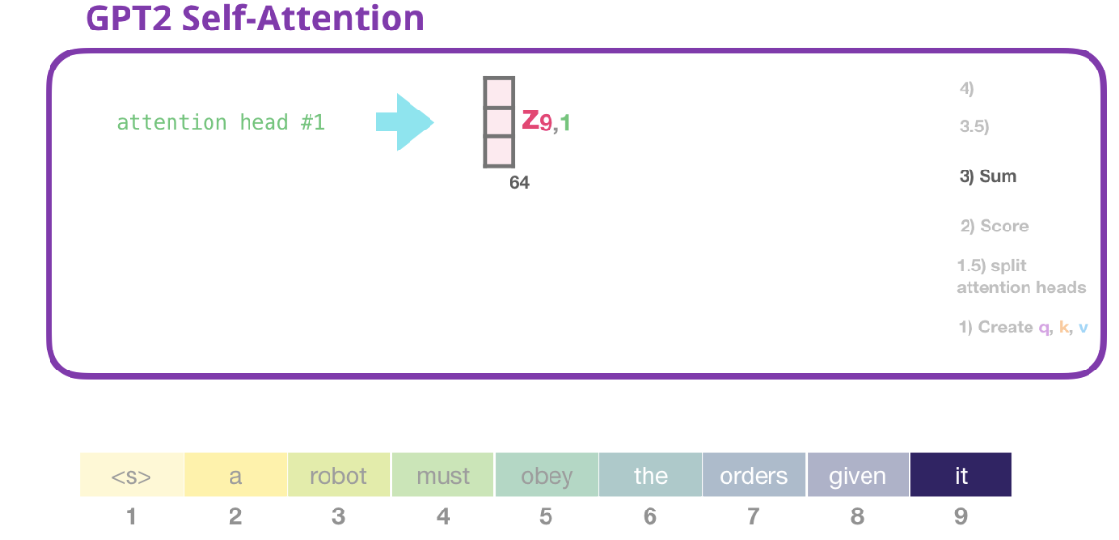
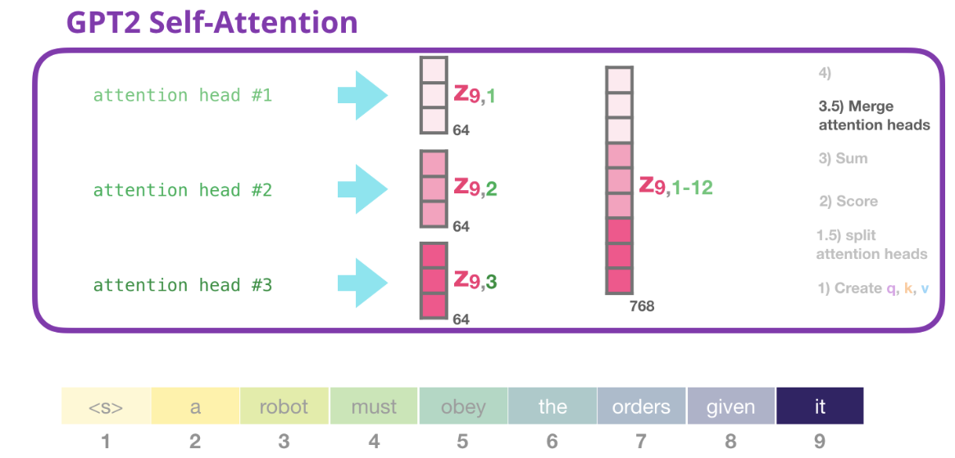
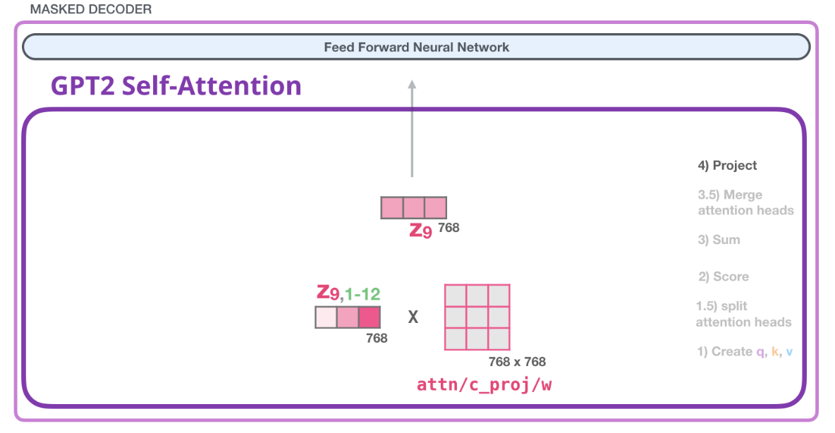
Splitting att-head
4. Project: how to best map concat self-att results into a vector that feed-forward can deal with

Slide 30
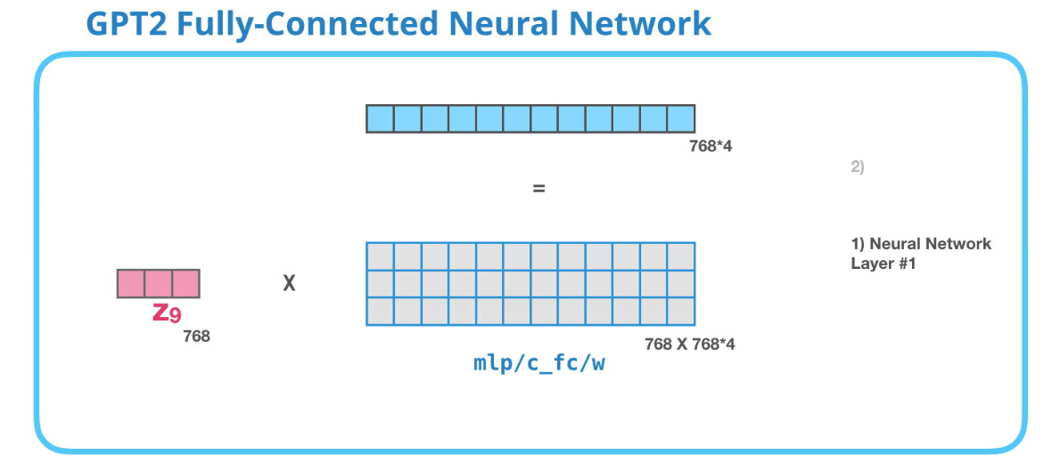
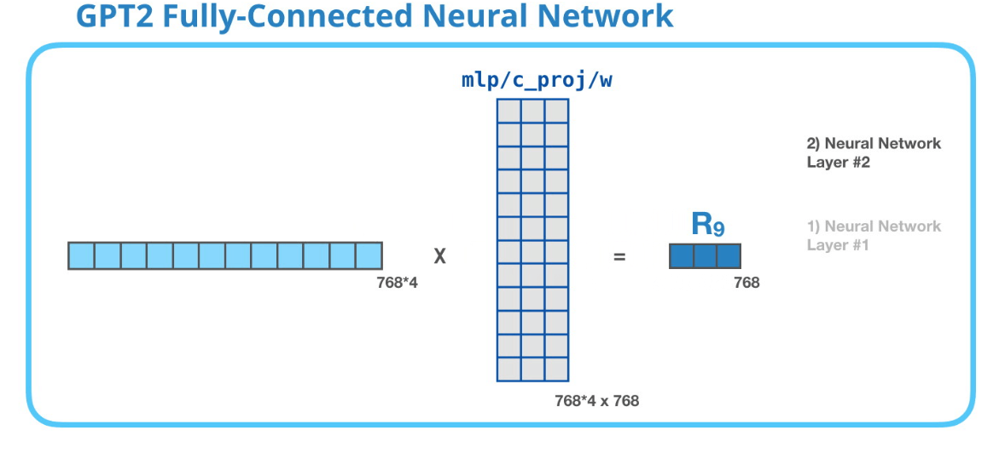
FCNN

Slide 31
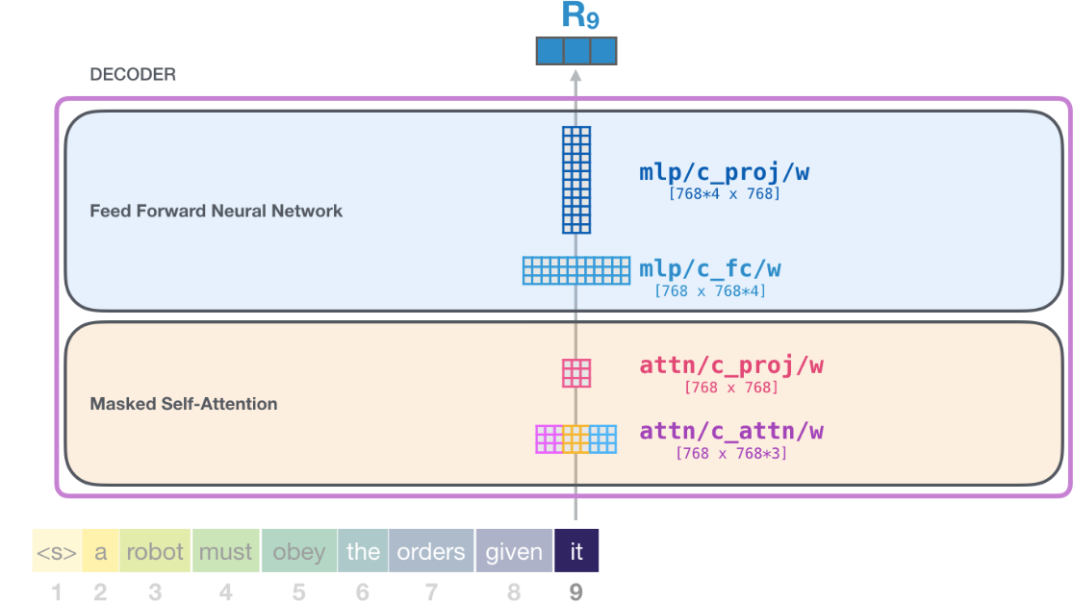
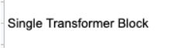
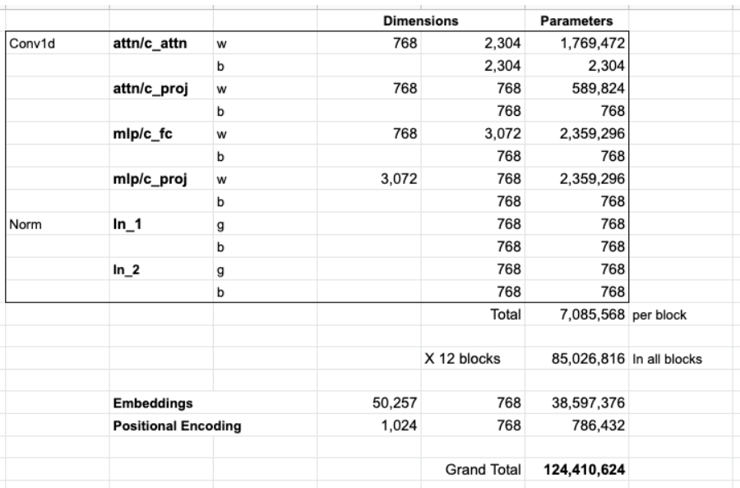
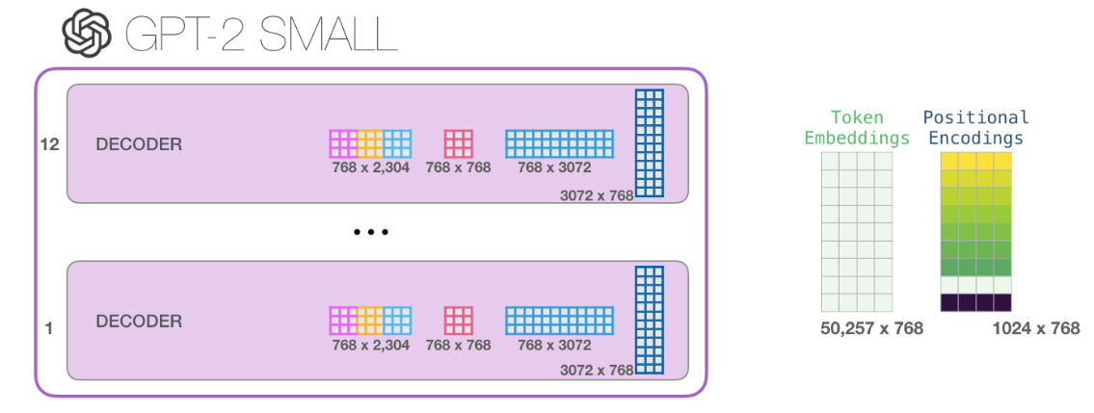
Recap
Model: each block -> own Ws + 1 pos/emb matrix

Slide 32

Beyond LM
Machine Translation: Don’t need encoder

Slide 33


Beyond LM
Summarization: The paper trained the model against wikipedia articles
labels

Slide 34
Beyond LM
Transfer Learning:
Decoder-only transformer is first pre-trained on LM.
Finetuned to do summarization.
-> better results than a pre-trained encoder-decoder transformer in limited data settings.

Slide 35


Beyond LM
Music Generation: “Music Modeling” is just like language modeling
Learn music in an unsupervised way -> sample outputs (rambling).
Eg: piano
Have to represent: notes, velocity, how hard the piano key is pressed.
Performance: series of 1-hot vec

Slide 36


Beyond LM
Music Generation:

Slide 37
Paper: Improving Language Understanding by Generative Pre-Training OpenAI

Slide 38
Abstract
large unlabeled text corpora
generative pre-training
challenging for discriminatively trained models
discriminative fine-tuning
(task-aware input transformations during fine-tuning)
absolute improvements of 8.9% on commonsense reasoning (Stories Cloze Test)
5.7% on question answering (RACE)
1.5% on textual entailment (MultiNLI).

Slide 39
Introduction
Học từ dữ liệu ko nhãn:
- Học vb thô -> giảm phụ thuộc học gs
Tận dùng tài nguyên lớn.
Tăng hiệu suất.
-> thách thức:
Ko rõ mục tiêu tốt ưu cho transfer
Ko có cách hiệu quả chuyển đại diện -> target task
semi-supervised =
unsupervised pre-training (language modeling objective -> học tham số)
+
supervised fine-tuning (corresponding supervised objective -> target task -> adapt tham số)
task-specific input adaptations - >fine-tune hiệu quả, ít thay đổi pre-trained
LSTM -> short range về cấu trúc ngôn ngữ
Transformer -> long-term
various objectives
- language modeling
- machine translation
- discourse coherence
- language understanding tasks
natural language inference
question answering
semantic similarity, and text classification.

Slide 40
Related work
Semi-supervised learning for NLP:
Word embedding (pre-train) -> word-level -> phrase/sentence-level.
Paper -> high-level semantic
Unsupervised pre-training:
- image classification
speech recognition
entity disambiguation
machine translation
Auxiliary training objectives:
Auxiliary unsupervised training objectives -> alternative form of semi-supervised learning
Cải thiện semantic role labeling.

Slide 41


Framework ::Unsupervised pre-training
Unsupervised corpus of tokens U = {u1, . . . , un}
Use standard language modeling objective
- Max log likehood (k: context window)
Use a multi-layer Transformer decoder
Use multi-headed self-attention operation followed by position-wise feedforward layers -> output: distribution over target tokens
U = (u_{−k}, . . . , u_{−1}): context vector
n: num of layers
W_e: embedding matrix
W_p: position embedding matrix

Slide 42




Framework ::Supervised fine-tuning
Labeled dataset C = {sequence of input tokens: x1 , . . . , xm; label y}
Out of pre-trained model
-> In of final transformer block’s activation $h_{l}^{m}$, fed into an added linear output layer with parameters W_y to predict y
Use auxiliary objective:
Improving generalization of the supervised model.
Accelerating convergence.
Extra parameters:
W_y
embeddings for delimiter tokens

Slide 43

Framework ::Task-specific input transformations
Vì pre-train được huấn luyện trên chuỗi liền kề vb, nên cần sửa đổi -> traversal-style (input có cấu trúc -> chuỗi sắp xếp để pre-train có thể xử lí):
Classification: directly fine-tune.
Textual entailment: premise p token + delimiter token $ + hypothesis h token.
Similarity (no inherent ordering): contain both (delimiter between) -> process independently -> 2 seq $h_{l}^{m}$ -> transformer -> + element-wise -> linear.
QA / Reasoning:
input: context document z, question q, set of possible answers {a_k}
Implement: z + q + $ + each a_k -> these sequences are processed independently -> transformer -> linear -> softmax (distribution)

Slide 44

Framework ::Diagram

